Slide 1
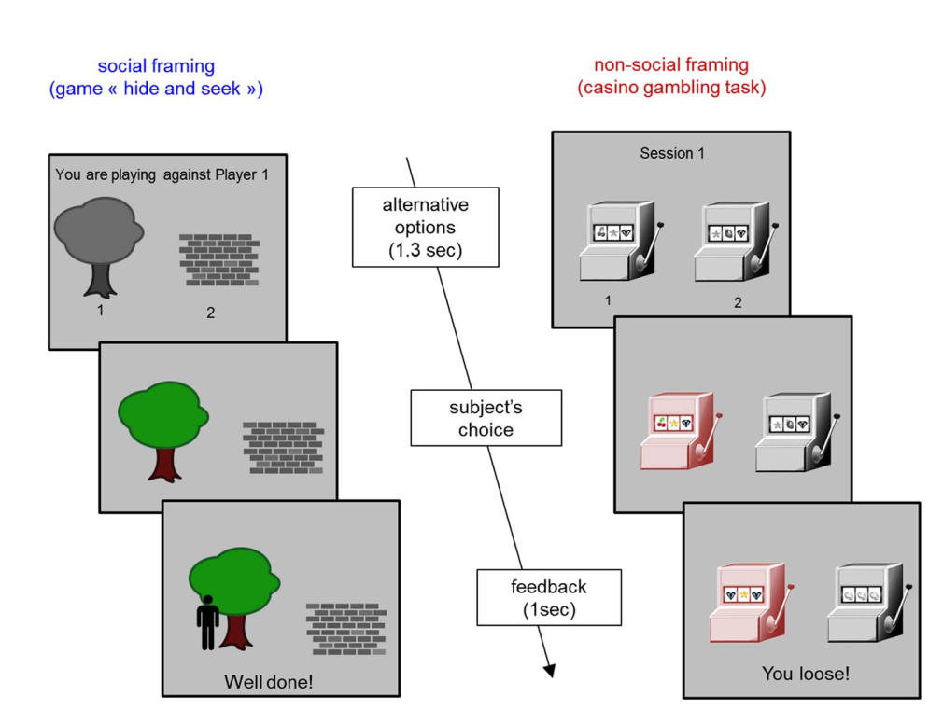
Experiment protocol
Deviane& Daunizeau, 2014

Slide 2
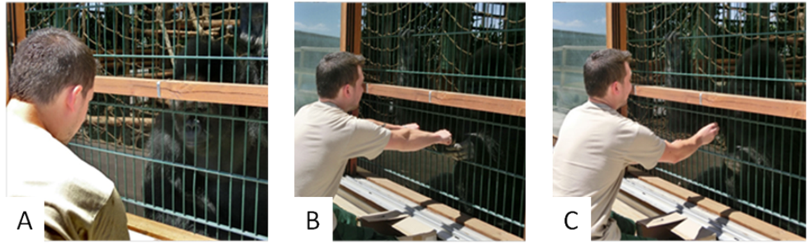
Experiment protocol
Training phase
Training phase
12 * 60 per day

Slide 3
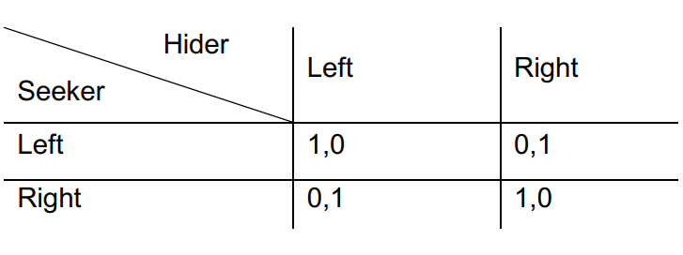
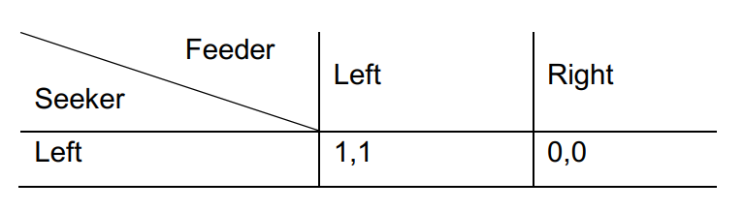
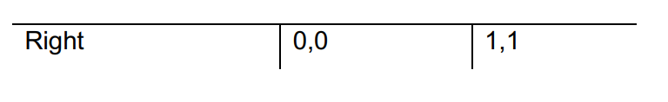
Experiment protocol
competitive
cooperative
RB: opponent behaviour pattern is fixed
0-TOM
1-TOM

Slide 4
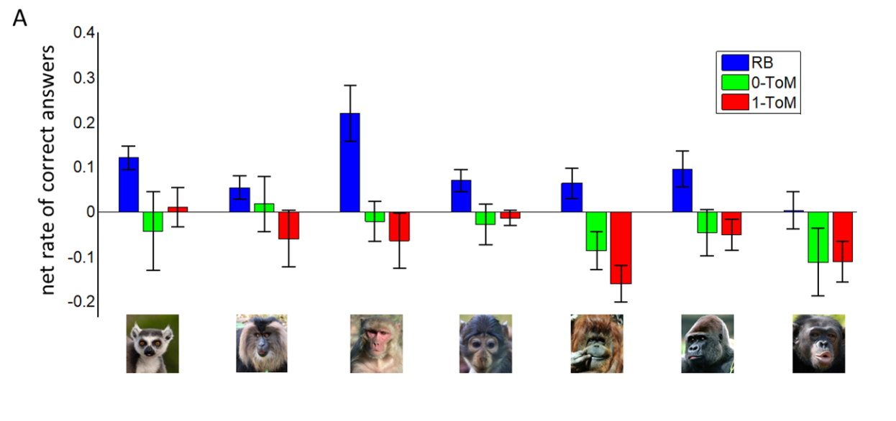
Model free analysis
ECV predicted overall performance, whereas group size did not.

Slide 5
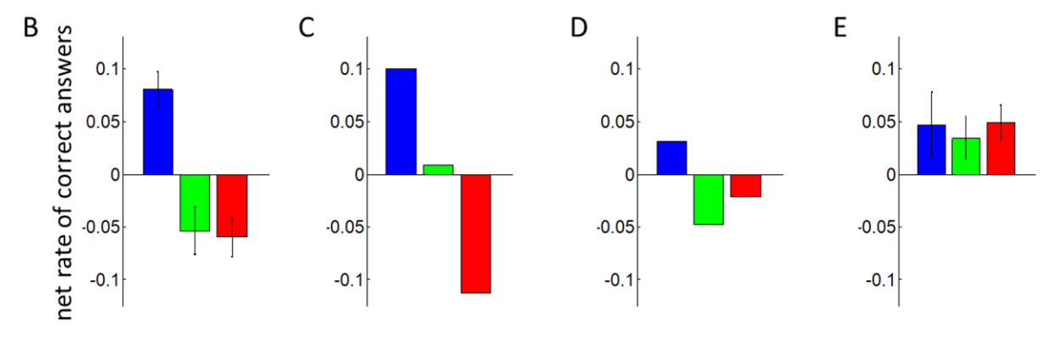
Model free analysis
primate
0-ToM
1-ToM
Human

Slide 6
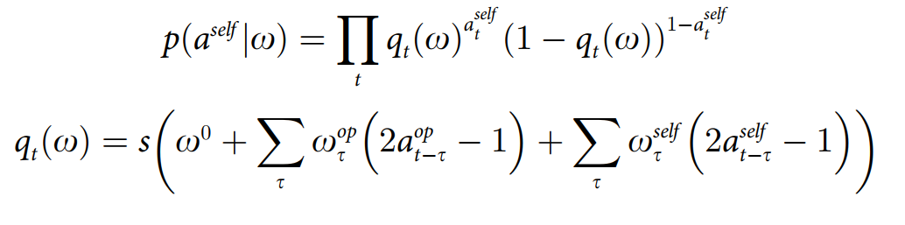

Volterra decompositions
Bernoulli distribution PDF
Dummy coding to effect coding

Slide 7
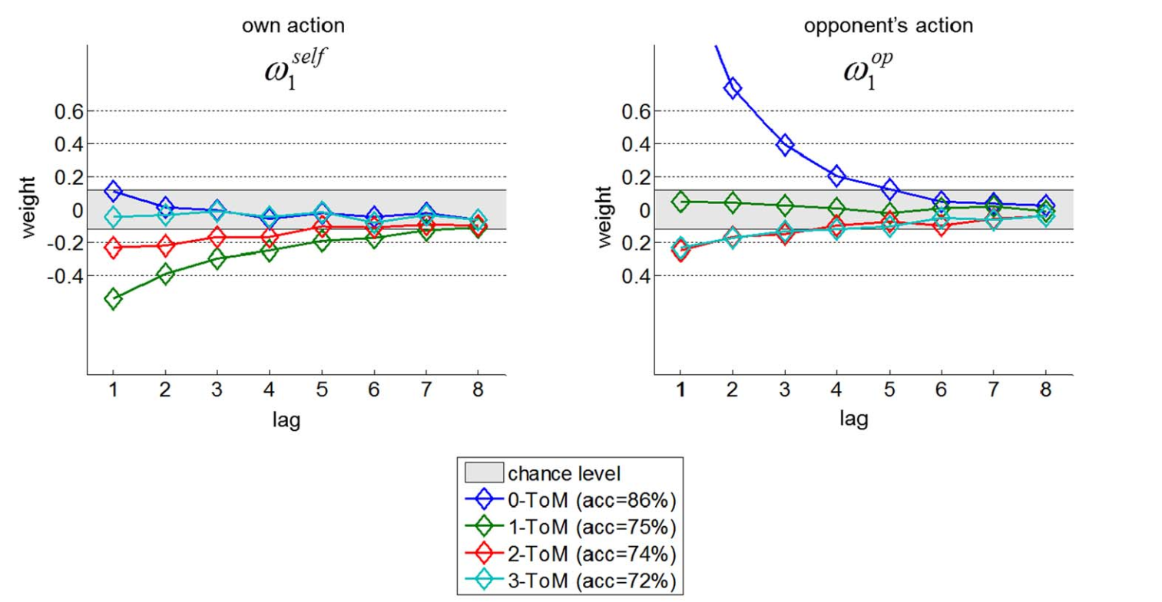
Volterra decompositions

Slide 8
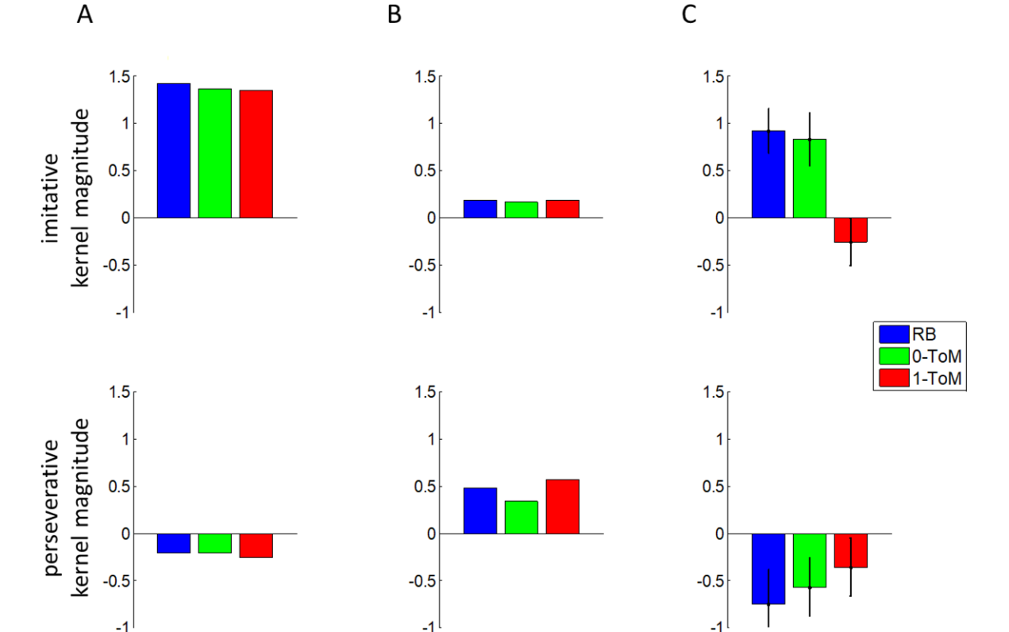
Volterra decompositions
0-ToM
1-ToM
Human

Slide 9
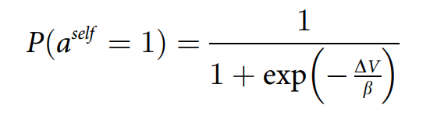
Computational Model
0-ToM

Slide 10
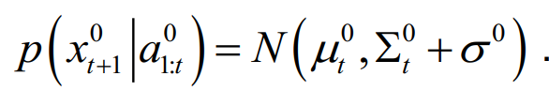
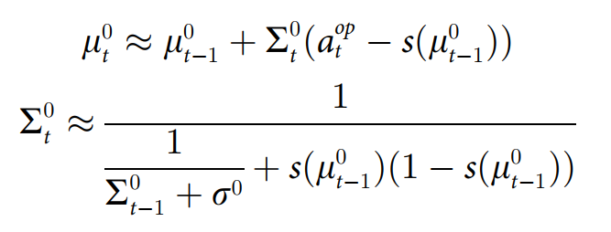
Computational Model
0-ToM

Slide 11
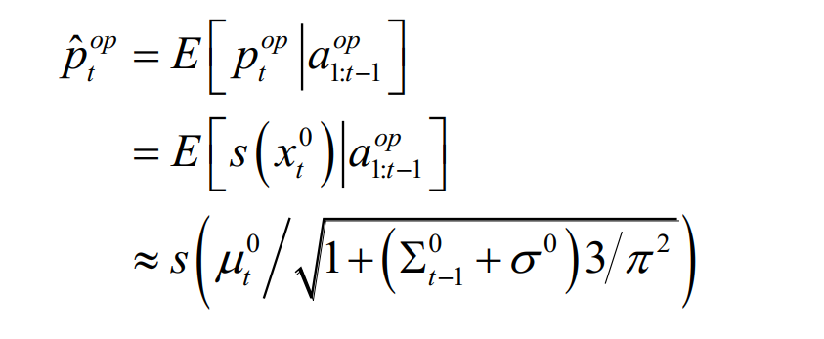
Computational Model
0-ToM

Slide 12
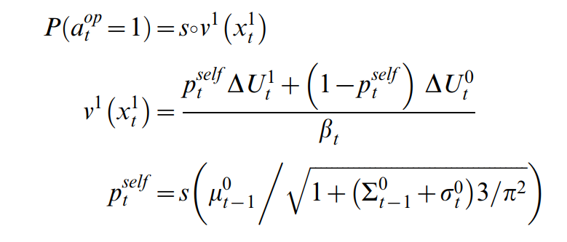
Computational Model
1-ToM

Slide 13
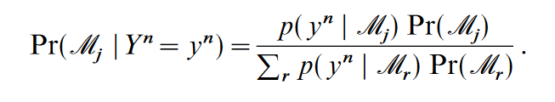
Computational Model
Bayesian model averaging
Wasserman, 2000

Slide 14
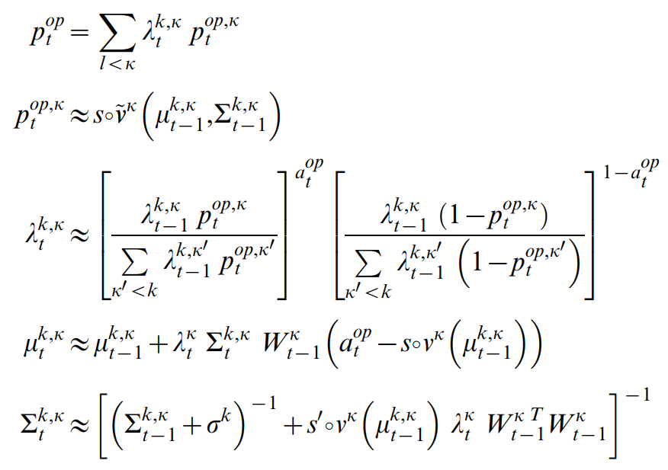
Computational Model
k-ToM

Slide 15
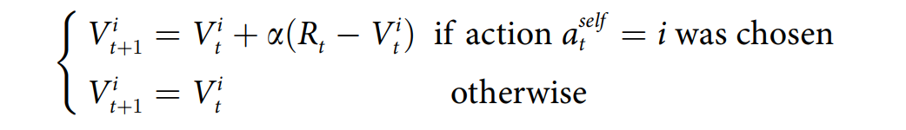
Computational Model
RL Model

Slide 16
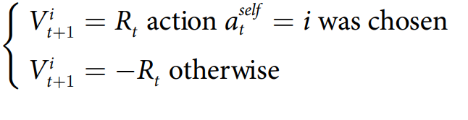
Computational Model
WSLS Model

Slide 17
Computational Model
Influence Model

Slide 18

Computational Model
Influence Model

Slide 19


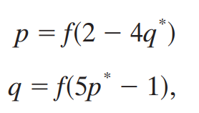
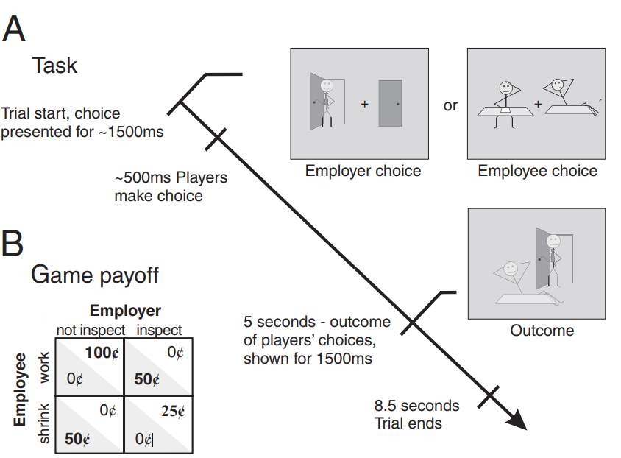
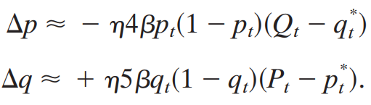
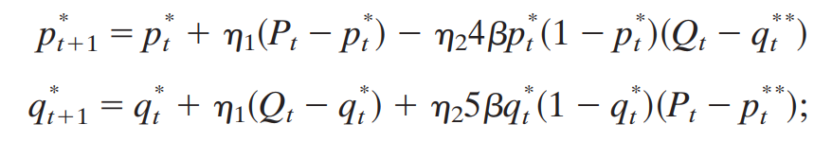
Computational Model
Influence Model

Slide 20
Computational Model
Model comparison
Machiavelian intelligence hypothesis
Cognitive scaffolding hypothesis

Slide 21
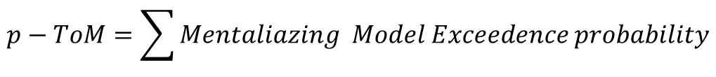
Computational Model
Model comparison
Machiavelian intelligence hypothesis
Cognitive scaffolding hypothesis
$$p−ToM=\sum{Mentaliazing Model Exceedence probability}$$

Slide 22
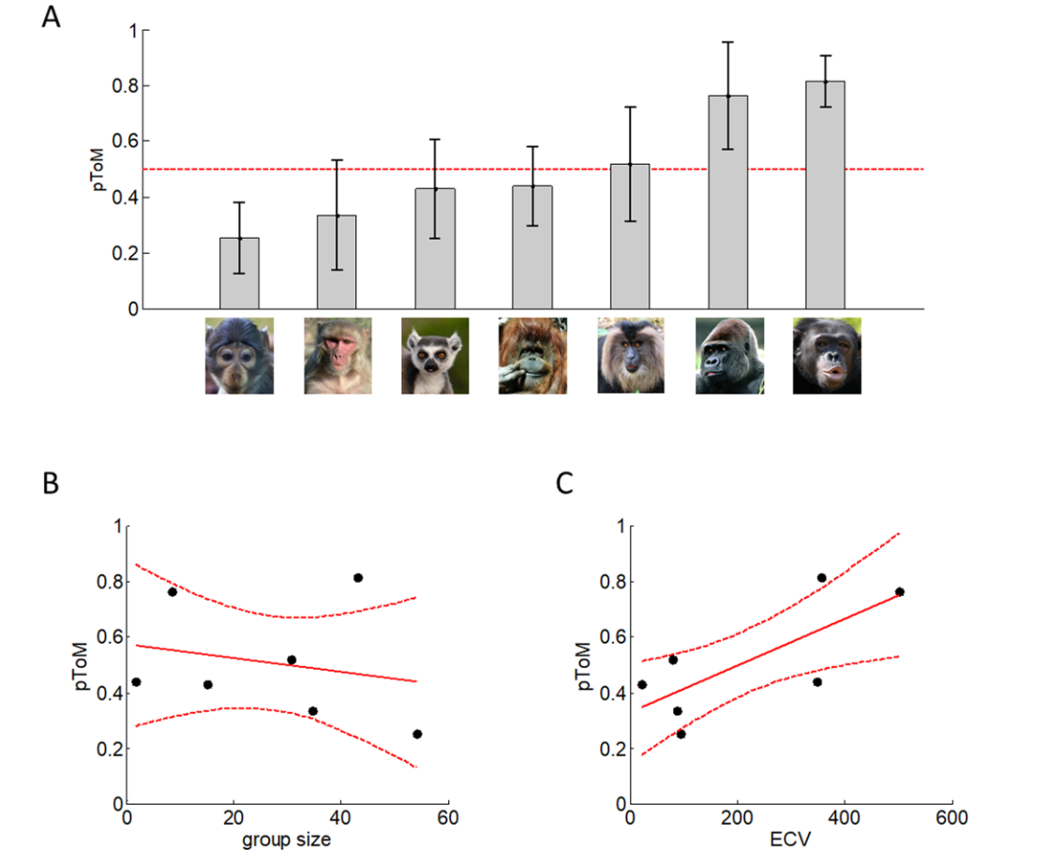
Computational Model
Model comparison

Slide 23
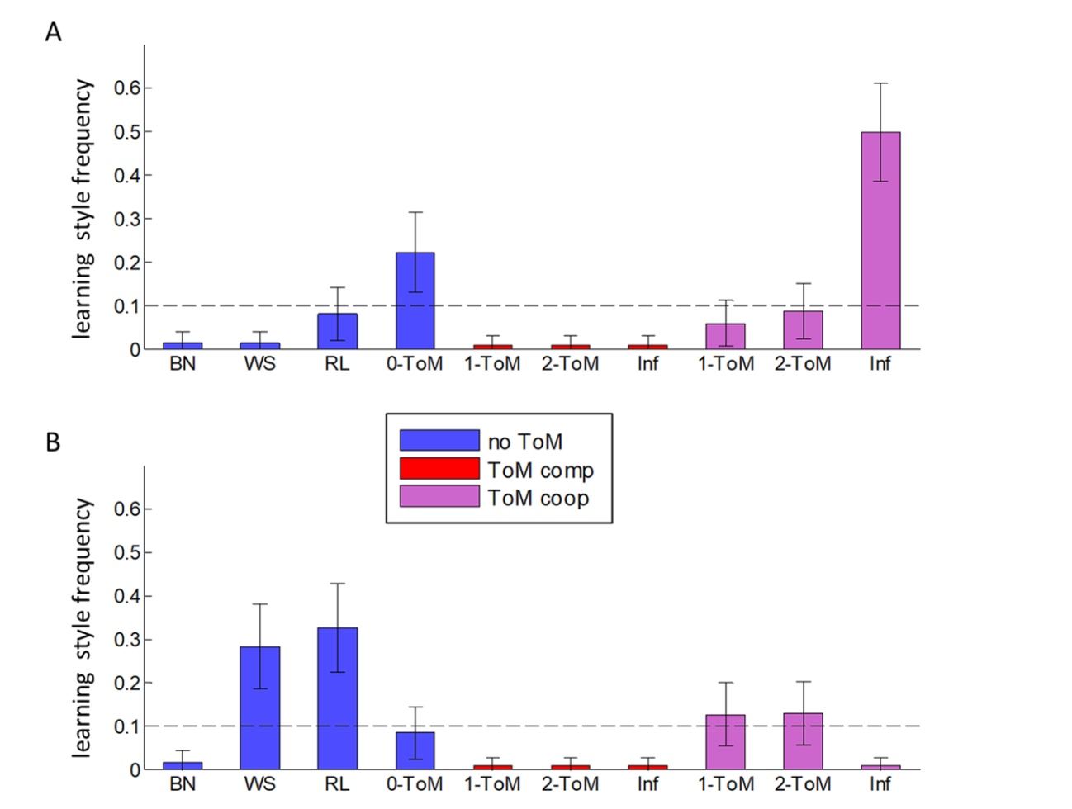
Computational Model
Model comparison
Large Brain Size
Small Brain Size

